Slide 1
IBM University Engagement Project Submission
“Exploring the Power of Agentic AI with IBM Granite and Orchestrate”

Slide 2

Project Tile – [Fitness Buddy]
Domain of Project – [ Healthcare ]
Student Name | Recent Passport Photo | Email ID | Mobile number [WhatsApp]
Deepak Dilip Phapale |  | deepakphapale2003@gmail.com | 7977275586

Slide 3
Problem Statement -
Problem Statement : Fitness Buddy
The Challenge
Good health is the foundation of life, but individuals often struggle with maintaining consistent fitness routines, staying motivated, and accessing personalized guidance. Information about workouts, healthy habits, and basic nutrition is scattered across unreliable sources. Without personalized, real-time support, many fail to build sustainable fitness habits or make informed lifestyle choices.
The Objective
Build an AI-powered Fitness Buddy that delivers personalized workout routines and lifestyle guidance for individuals. The solution should:
Personalized Workout Plans – Recommend home workouts and routines based on age, fitness level, available time, equipment, and personal goals.
Motivation & Habit Tracking – Provide daily motivational tips, fitness inspiration, and reminders to encourage consistency and habit-building.
Basic Nutrition Guidance – Suggest simple, nutritious meal ideas that complement fitness goals without complex calorie counting.
On demand Fitness Coach – Allow users to ask fitness questions via chat/voice and get instant,friendly advice available 24×7.
Progress Monitoring – Track workout completion, streaks, and basic milestones to visualize improvement and maintain engagement.
Multi-Agent System –
Fitness & nutrition Knowledge Agent (fetches fitness & nutritional data)
Diet Recommendation Agent (personalized meal plans)
Health Advisory Agent (preventive health suggestions)
Visualization Dashboard – Show daily/weekly nutrient intake, deficiencies, and progress toward health goals.

Slide 4
Technology Used
Tech Stack (Mandatory)
I used watsonx Orchestrate+ IBM watsonx.ai + IBM Granite Models on IBM Cloud Lite

Slide 5
Proposed Solution -
Proposed Solution: AI-Powered Fitness Agent The proposed solution is an AI-powered conversational Fitness Buddy built using IBM watsonx Orchestrate and IBM Granite Models to provide personalized, real-time fitness guidance and motivation. The system addresses challenges in workout planning, habit consistency, and accessible fitness coaching through an intelligent, conversational interface. At its core, the solution uses IBM Granite LLM integrated with watsonx Orchestrate to understand user queries in natural language and provide context-aware responses. The system leverages built-in tools and custom skills to deliver comprehensive fitness support without requiring complex infrastructure.
The solution consists of four key components: Workout Recommendation Engine generates personalized home workout routines based on user inputs such as age, fitness level, available time, equipment, and specific goals like weight loss or muscle gain. Motivation & Habit Coach provides daily motivational messages, fitness tips, and consistency reminders to help users build sustainable habits and overcome workout procrastination. Basic Nutrition Guide suggests simple, healthy meal ideas that complement workout routines, focusing on protein intake, hydration, and post-workout recovery without complex calorie tracking. Progress & Engagement Tracker monitors workout streaks, completed sessions, and basic milestones to visualize improvement and maintain user engagement through positive reinforcement. The solution includes a user-friendly chat interface built within watsonx Orchestrate that allows users to interact via text, available 24x7 on web and mobile. IBM watsonx Orchestrate handles agent orchestration, tool integration, and conversation flow, while Granite model power reasoning, personalization and natural dialogue generation.

Slide 6
Orchestrate Component Use -
Watsonx Orchestrate Components Used – 1) Chat Interface – User-facing chat UI where users enter fitness queries, goals, or ask for workout advice via text/voice. 2) IBM watsonx Orchestrate Agent – Core agent that understands user intent and orchestrates the conversation flow using IBM Granite LLM to generate personalized workout plans and motivational responses. 3) Name of IBM Granite model – Default → Optimized for instruction following, natural dialogue, and personalized coaching responses. 4) Built-in Tools Used – - Web Search Tool: Fetches latest fitness tips and exercise form guidance - Calculator Tool: Computes workout intervals, BMI, and basic fitness metrics - DateTime Tool: Manages workout schedules and streak tracking 5) Conversation Memory – Maintains chat history to track user progress, remember workout streaks, and provide consistent habit-building

Slide 7
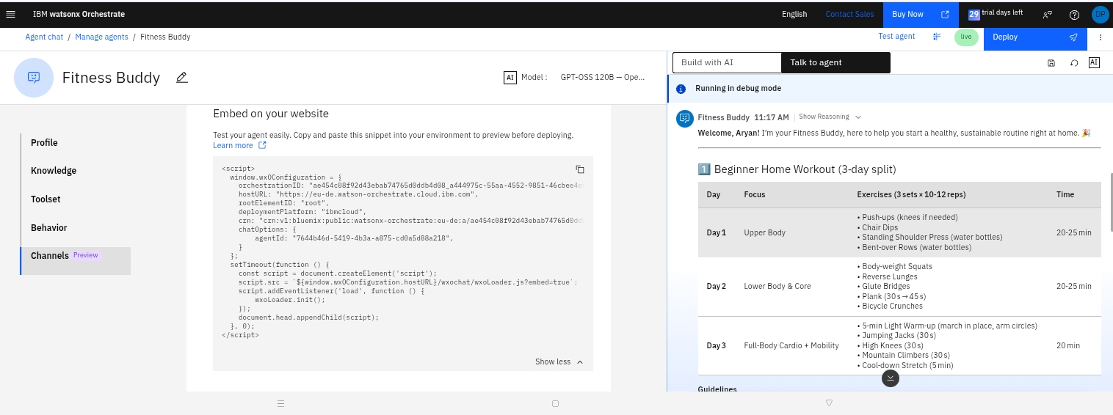
Watsonx orchestrate Health Agent -

Slide 8
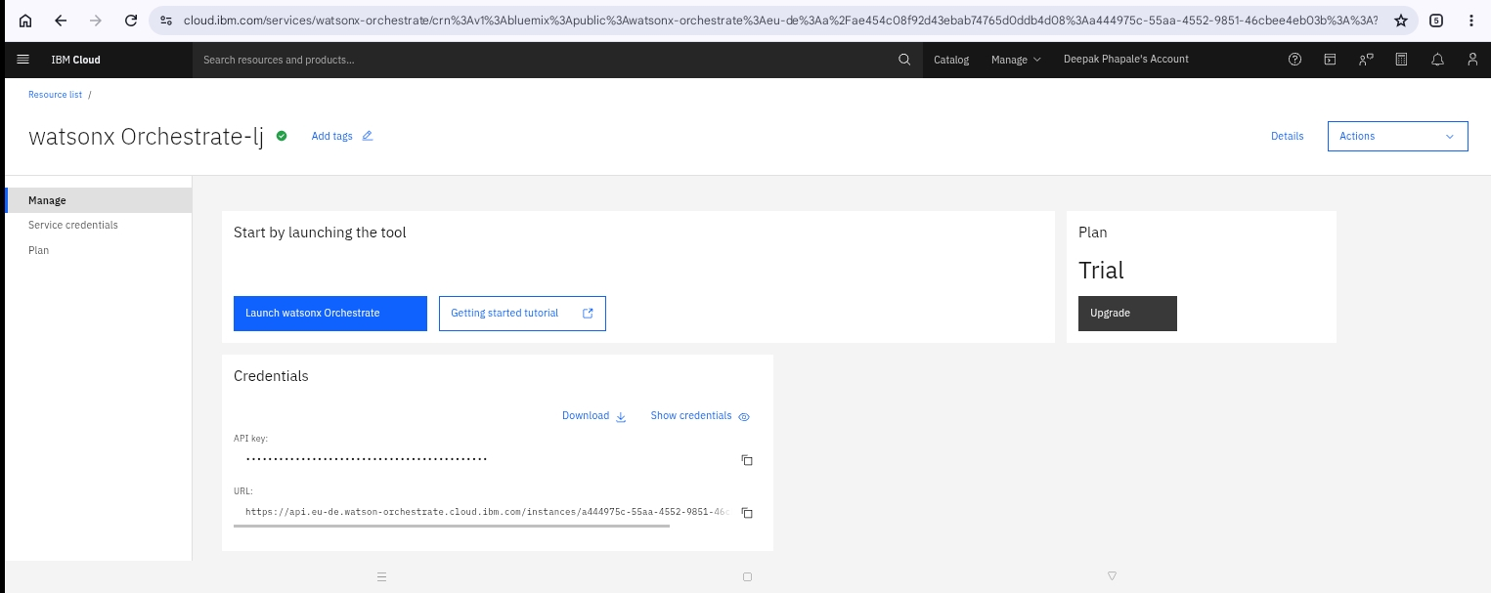

Slide 9
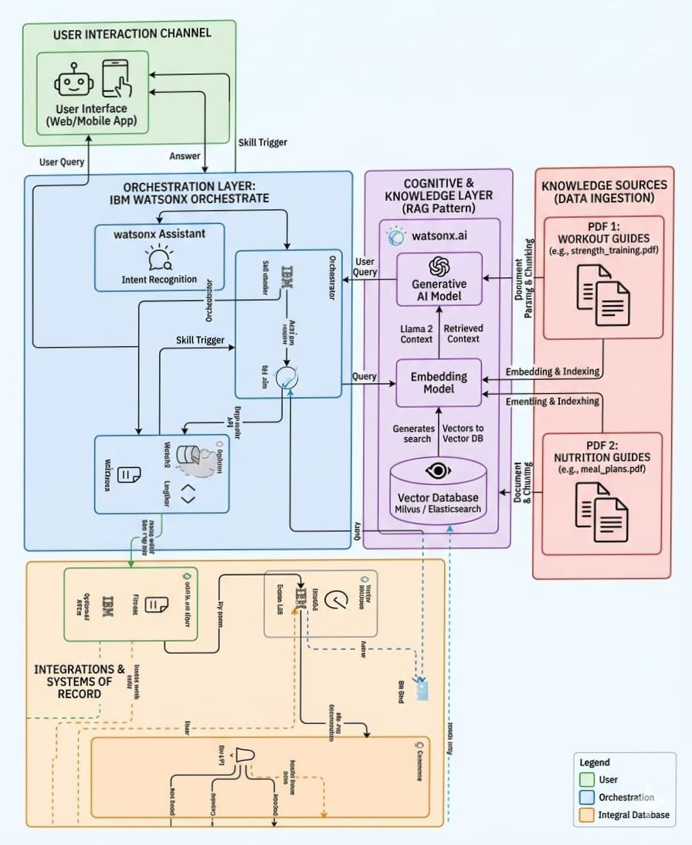
Architecture blueprint

Slide 10

Role of Agentic AI in the solution
Role of Agentic AI in fitness Agent
Agentic AI enables the Fitness Agent to function as an intelligent, autonomous system rather than a simple chatbot. Using IBM watsonx.ai and IBM Granite models, it coordinates multiple specialized agents to deliver personalized Fitness and nutrition intake guidance. Each agent performs a specific role—such as retrieving Fitness data, generating plans, providing health advice, and analyzing food logs—while working collaboratively. This multi-agent approach ensures efficient task execution and accurate results.
Agentic AI also brings context awareness, understanding user details like age, health conditions, and fitness goals to generate tailored recommendations. It supports real-time adaptation, continuously updating suggestions based on user inputs like daily meals.
Additionally, agents communicate with each other, enabling better decision-making and improved outcomes.
Overall, Agentic AI makes the system proactive, personalized, and goal-driven, acting like a smart digital nutritionist that helps users maintain a healthy lifestyle.

Slide 11
Technology Used
• IBM watsonx Orchestrate – For designing and orchestrating the single-agent fitness coach. Provides built-in chat UI, tool integration, and conversation management without custom coding. • IBM Granite Model – Default– For natural language understanding, workout plan generation, and personalized motivational coaching. Optimized for instruction following and safe dialogue. • IBM Cloud Lite – Provides reliable, secure, and scalable environment for deploying the Fitness Buddy agent. Handles hosting, scaling, and API management automatically. • Built-in Tools – Web Search Tool for latest exercise forms, Calculator Tool for BMI/workout intervals, DateTime Tool for streak tracking and scheduling. No external databases required. • Orchestrate Skills & Memory – Custom Skills store user profile like fitness level, equipment, goals. Conversation Memory maintains chat history and workout streaks for context-aware coaching. • IBM watsonx.ai – For hosting and inferencing the Granite foundation model. Provides enterprise-grade AI governance and safety.

Slide 12
Novelty and Uniqueness
The proposed Fitness Buddy stands out by combining Agentic AI, Tool Use, and Habit-Building into a single intelligent fitness coach system. Single-Agent Intelligence – Instead of complex multi-agent systems, watsonx Orchestrate uses one autonomous agent that handles workout planning, motivation, and progress tracking. The agent proactively decides when to use tools, ask follow-ups, or give encouragement. Tool-Augmented Accuracy – Integrates real-time Web Search for latest exercise forms and Calculator for accurate BMI/intervals, ensuring trustworthy workout guidance without hallucination. Hyper-Personalization – Adapts recommendations based on fitness level, available equipment, time constraints, and goals. No generic YouTube workouts – every plan is tailored. Habit-Building Focus – Goes beyond workout generation to maintain consistency. Tracks streaks, sends motivational nudges, and handles excuses using DateTime Tool + Granite LLM for empathetic coaching. Zero-Code Agentic Flow – Built on IBM watsonx Orchestrate with IBM Granite models, ensuring enterprise-grade reliability and AI governance without complex RAG pipelines or vector databases. This makes the solution a smart, adaptive, and proactive digital fitness buddy, not just a static workout list generator.

Slide 13
Git Hub Link
Working Github URL – https://github.com/deepak2003-tech/Fitness-agent-
Uploaded following three files into github repository 1) index.html file , 2) projectpresntation.pptx file , 3)app.json file
·
·
·

Slide 14
Future Scope
·1. Integration with Wearables & Fitness Trackers – The system can be integrated with smartwatches and fitness bands to collect real-time data such as steps, heart rate, and active minutes. This will enable the Fitness Buddy to provide more accurate and dynamic workout recommendations based on actual user activity and recovery metrics. 2. AI-Powered Voice Coach & Multilingual Support – Enhancing the system with a voice-enabled assistant and support for multiple Indian languages like Hindi, Tamil, Telugu. Users can interact naturally during workouts in their preferred language, making the solution more inclusive for diverse populations across India. 3. Video Form Correction using Vision Models – Future versions can integrate with device cameras to analyze user exercise form in real-time. The agent can provide instant feedback on posture and technique using IBM
·

Slide 15


